Slide 1
The
Defensive Coordinator
Workbook
Quint Ashburn
Kenny Simpson
Emory Wilhite
A Find a Way Publication

Slide 2
Copyright © 2022 by Kenny Simpson
All rights reserved.
ISBN: 9798432085672
fbcoachsimpson.com

Slide 3
Thank You
With anything in life worth having, there are always people involved. Those that stand with you and stand for you at times when you need them the most. I have more of these people in my life than I deserve.
Thank you to the following:
To my wife – those that know Jamey realize quickly that I married up. She is the glue to our family and pretty much anything that I accomplish that is worth much.
To my children – I am very blessed to have three children that make me proud every day. They each have their special talents, but all are special.
To my coaches – I can be VERY difficult to work with and I appreciate those that have guided me and put up with me through many times that I did not deserve their patience.
To my players – Nobody coaches for the money, we all coach for the players. The relationships I have formed and great people I’ve been blessed to have watched grow up has made this journey worthwhile.
To Emory Wilhite – A huge thank you for partnering with me to bring a material that I hope can help coaches for years to come.
To Quint Ashburn - A bright mind and one of the most genuine people I know. It was great to work together on this project.
To Pro Quick Draw – Thanks to all those involved in helping this old coach figure out templates and how to become part of the modern age of coaching. For those interested in learning more about their great product:
Most of all…
To the coaches – Thank you for all you do for your athletes. Please always feel free to reach out to me if I can help in any way. Your work is not always thanked by those you impact the most, but I promise, you are making a difference.

Slide 5
Table of Contents
Preface | 7
Introduction | 9
Chapter 1: Personnel | 11
Chapter 2: Terminology | 23
Chapter 3: Fronts | 43
Chapter 4: Coverages | 67
Chapter 5: Stunts | 91
Chapter 6: Packaged Calls | 113
Chapter 7: Readiness Exercises | 125
Chapter 8: Practice Planning | 133
Chapter 9: Drill Book | 141
Chapter 10: Opponent Breakdown | 179
Chapter 11: Opponent Game Planning | 193
Chapter 12: Build a Call Sheet | 195
Chapter 13: Game Management | 197
Conclusion | 203
About the Authors | 205

Slide 7
Preface
Creating a defensive system that is reliable and consistent can be extremely difficult in today’s game of football. Offenses are on fire in today’s game with the many motions, shifts, and tricks that can expose a defense to many different styles of play.
This workbook is meant for you and your defensive staff or head coach to go think through the many questions that you will need to answer about how you need to build your defense in order to be successful in the league that your team is in. While you won’t be able to cover everything in this workbook, you will have a solid foundation to build your defense to your needs.
Each section is built around a certain topic or question that you need to work through prior to the season so that you can build your defense knowing you have addressed the major points and concerns that lead to successful defenses.
My hope is that by working through this book, you will have a much better understanding of your own team and system.
My contact information is:
FBCoachSimpson@gmail.com
334-549-9382
​
DISCLAIMER
I am very thankful that you chose to purchase this workbook whether that be print or digital. I understand that it is easy to share documents online these days, but I would appreciate if you did not.
If you got this workbook for free, please consider supporting me at
fbcoachsimpson.com

Slide 9
Introduction
When building your defense, you must work through the different scenarios that opposing offenses will put you through. This workbook will give you a variety of exercises to complete to ensure that you’ve addressed all the major points that you need to think about to put your team in the best position to defend the offenses that you will see.
Here’s a few topics you’ll work through and the questions you’ll answer:
Personnel - Who are the starters for your defense? Do you have lots of depth or are you thin in certain positions? Is your next best defensive end the backup linebacker? Will you build in personnel packages?
Stunts and Fronts - What are the main fronts that you want your defense in against the offenses you will see each Friday night? What are your go to stunts that you will use when you need pressure? What coverages are you going to live in this season?
Coverage - How will you marry your coverages with your fronts and stunts? What adjustments will you build in for formations from the offense?
Packaged Calls - Will you package blitzes and the coverages with simple call? How will you communicate to the defense?
Game Organization - How will you organize your coaches? How do adjustments get made?
Practice Plans - How much time do you want to spend on individual defensive drills? When do you want the box to come together to work against the run? How much time should the linebackers and defensive backs work coverages together?
Practice Drills – What drills are most important? Key coaching points? What drills should your assistant coaches emphasize?
Opponent Breakdown - While this could be an entire book, this workbook will provide a few templates to use as you breakdown your opponents.
Build a Call Sheet - What kind of sheet will you use to call your defense? What information goes into this call sheet? How will you lay it out?
​

Slide 10
Think of this workbook as a tool to help think through all the situations your defense will encounter this season and in future seasons. The goal is to be as prepared as possible.
And while a coach can never predict the future with 100% certainty, we can be as prepared as possible. The goal of this workbook is to have a finished product at the end of the workbook.
If you have interest in more guidance, we are planning to add the Defensive Coordinator Academy coming later in 2022!
Also, as you go through the workbook, you might find that you need more sheets than were provided. If that’s the case, scan the QR code below to download additional sheets for printing.
​

Slide 11
Chapter 1
Personnel
Making sure you have the right players in the right positions is the most important aspect of coaching defense. Great players always help, but the coaches that can use players to the best of their ability and design an offense to match the skill set are those that become elite. This can be tricky at times because you may not have the ideal 11 players to put in every single position on your defense. One position group may not have a lot of depth.
So use this section to brainstorm and find out the strengths and weaknesses of your roster. If your defensive line is thin on backups, do you have a backup linebacker that can take reps at defensive end when you need him to? If a outside linebacker goes down in a game, who will back him up? The answers to these questions can make or break you when all the chips are on the table. You should always start with your players before building out your playbook and then match the concepts and formations to maximize the strengths of your players.
Building If-Then Into Your Decisions
As you work though this workbook, think about all the possibilities that can come up through a season. I refer to this as “IF-THEN” thinking.
As you build your roster and depth chart, be sure to think about:
IF: “X” player is injured; THEN: we would use “Y” player
IF: we do not have enough depth at “X” position; THEN: we could look at “Y” at that spot.

Slide 12
Personnel and Structure
Deciding on what defensive structure to run is also a must. Will you base from a 3-4 look or a 4-3? Do you want to play with 3 safeties or play more linebackers?
While each coach must decide for himself, the suggestion we would give is to work through this section and don’t force a square peg in a round hole. Or simply put, find the defensive structure that gets your best players on the field in areas they can succeed.
Teams have won multiple championships in the 4-3, the 3-4, and the 3-3 stack. The reality is that your defensive system needs to be able to fit your talent. Use these exercises as a tool to help flesh out what fits your athletes.
In the first exercise you will put your primary defensive players on paper and make notes on each one. Use this exercise to really dive deep into your players and their strengths and weaknesses so that you’ll be better prepared when you start to make structure and depth chart decisions.
The next exercises will have you then put those players into a depth chart from the varsity level all the way to the youth level if you are connected to those teams as well.
Lastly, you’ll put your players in special personnel packages that you might need for passing downs, goal line, or whichever you think necessary to address the offenses you will see.

Slide 13
Exercise 1
Layout Your Players
Position | Name | Notes

Slide 14
EXAMPLE EXERCISE
Establish a Varsity Depth Chart
Write out all 11 of your positions on the left and your expected depth chart. Use the bottom section to work through the strengths and weaknesses of your position groups.
Some things to think about:
Distinguish by grade - this will help to ensure that you are developing depth in all grade. In this example we used italics, underlining and bold to show a grade difference.
Some of the players backup at other positions - instead of being “stuck” with your 22nd best player, put players as you would realistically use them.
Position | Players
DL | Haas | Rich | Milikin
DL | Case | Sutton | Williams
DL | Wallis | Miller | Johnson
DL/LB | Simpson | Wilhite | Stewart
LB | Coleman | Wilson | Dunne
LB | Parker | Dockins | Weaver
LB/DB | Siler | Smith | Majors
CB | Smith | Johnston
CB | Foster | Siler | Majors
FS | Fowler | Johnston
SS | Jennings | Majors
Strengths | Weaknesses
DL Depth is strong | Need to find more safties
Have multiple seniors starting (italics) | Do not have many juniors (underlined)
Strong 10th grade class (bold)

Slide 15
Exercise 2
Establish a Varsity Depth Chart
Write out all 11 of your positions on the left and your expected depth chart. Use the bottom section to work through the strengths and weaknesses of your position groups.
Position | Players
Strengths | Weaknesses

Slide 16
Exercise 3
Establish a JV Depth Chart
Write out all 11 of your positions on the left and your expected depth chart. Use the bottom section to work through the strengths and weaknesses of your position groups.
Position | Players
Strengths | Weaknesses

Slide 17
Exercise 4
Establish a JH Depth Chart
Write out all 11 of your positions on the left and your expected depth chart. Use the bottom section to work through the strengths and weaknesses of your position groups.
Position | Players
Strengths | Weaknesses

Slide 18
Exercise 5
Establish a Youth Depth Chart
Write out all 11 of your positions on the left and your expected depth chart. Use the bottom section to work through the strengths and weaknesses of your position groups.
Position | Players
Strengths | Weaknesses

Slide 19
Special Personnel Groups
There will be situations in key games where your defense will need a change of pace to get stops or turnovers in order to turn the game to your favor or to get the ball back to your offense. In this case, you will need your absolute best athletes on the field at one time. You may have to borrow some of your offensive players that could double as defensive skill players, bigger linemen, or use faster players for a pass rush.
Think on the personnel you have in your defense. Who would you keep in the game? Who could you sub out for a better athlete to make a quick play, tackle for loss, or get a key interception to change the pace of the game or hold off the offense from scoring at the half or end of a close game? This is also the section to include your sub-personnel groups like nickel or dime packages.
The following chart will have room for you to make this special package and will have space for you to take notes on who you want in or out and why.

Slide 20
Exercise 6
Layout Your Personnel Groupings
Fill out the charts to map out your personnel groupings. In the last column on the right, at the top, name who is in the personnel. Then plan out the depth for each personnel grouping.
Tag | Coverages | Stunts | Grouping
Coverage
Coverage
Coverage
Stunt
Stunt
Stunt
4 DE, 1 LB, 6 DB
Notes on personnel
DIME
Tag | Coverages | Stunts | Grouping
Notes on personnel
Tag | Coverages | Stunts | Grouping
Notes on personnel

Slide 21
Exercise 6 Continued
Tag | Coverages | Stunts | Grouping
Notes on personnel
Tag | Coverages | Stunts | Grouping
Notes on personnel
Tag | Coverages | Stunts | Grouping
Notes on personnel

Slide 22
Exercise 6 Continued
Tag | Coverages | Stunts | Grouping
Notes on personnel
Tag | Coverages | Stunts | Grouping
Notes on personnel
Tag | Coverages | Stunts | Grouping
Notes on personnel

Slide 23
Chapter 2
Terminology
Each defense has their own “language”. In these exercises, you will start the process of getting your staff and team to speak the same language by listing, naming, and defining all the terms you will use. Your goal as the head of the defense is to make sure that everyone is on the same page and that there is no confusion when you communicate.
Exercise 7 will have you draw up formations and come up with names for them. This can be as simple as “trips” and “twins” or you can break it all up by personnel and backfields – the choice is yours, and as long as everyone knows, you’ve done your job.
Exercise 8 will be the start of a glossary for your defense. Every time you use a word to describe a technique, a scheme, a route, or a concept, write it down here and define it. Use this exercise as needed – don’t try to think of everything right now. As you progress through the workbook, come back here and write in the term and define it.
Exercises 9-11 will allow you to draw up position specific terms to be even more clear. Some terms you might want to simply write a definition, but there are others that you might want to draw. This could be a technique or concept.
There are many ways to communicate with your players, but they all must quickly understand what you are saying and asking them to do. Spend a good amount of time here to work all that out.

Slide 24
Exercise 7
Formation Recognition
Draw up the formation and give it a name so that you, your staff, and your players are on the same page and speaking the same language. Below is an example, and the following pages are for you to fill out.
GUN FAR FLEX | ACE TREY
ACE DOT | GUN NEAR TRIPS BUNCH
Q
T
T
Z
H
Q
H
X
Y
X
Y
Z
T
T
Q
Z
Q
X
Z
H
Y
X
Y
U

Slide 25
Exercise 7 Continued
Notes:
May be a good idea to make this a 2 x 2 with a notes section underneath it.

Slide 26
Exercise 7 Continued
Notes:
May be a good idea to make this a 2 x 2 with a notes section underneath it.

Slide 27
Exercise 7 Continued
Notes:
May be a good idea to make this a 2 x 2 with a notes section underneath it.

Slide 28
Exercise 7 Continued
Notes:
May be a good idea to make this a 2 x 2 with a notes section underneath it.

Slide 29
Exercise 8
Terminology Glossary
TERM | DEFINITION
Pursuit Angle | an angle from where you are to where you can intersect the ball carrier on the sideline.
Contain | to turn the ball carrier inside without widening the alley.
​

Slide 30
Exercise 8 Continued
TERM | DEFINITION
Notes:
May be a good idea to make this a 2 x 2 with a notes section underneath it.

Slide 31
Exercise 8 Continued
TERM | DEFINITION
Notes:
May be a good idea to make this a 2 x 2 with a notes section underneath it.

Slide 32
Exercise 8 Continued
TERM | DEFINITION
Notes:
May be a good idea to make this a 2 x 2 with a notes section underneath it.

Slide 33
Exercise 9: Defensive Line Terminology
In | Out
EXAMPLE | EXAMPLE
E
N
E
E
N
E

Slide 34
Defensive Line Terminology Continued

Slide 35
Defensive Line Terminology Continued

Slide 36
Exercise 10: Linebacker Terminology
Creep
EXAMPLE
E
N
“Creep” when cadence position
E
B
B
Before cadence position

Slide 37
Linebacker Terminology Continued

Slide 38
Linebacker Terminology Continued

Slide 39
Exercise 11: Defensive Back Terminology
Tight | Loose
EXAMPLE | EXAMPLE
“Tight Alignment”
“Loose Alignment”
C
C

Slide 40
Defensive Back Terminology Continued

Slide 41
Defensive Back Terminology Continued

Slide 43
Chapter 3
Fronts
Now that you know your personnel and have started to establish your terminology, it’s time to start building out the playbook.
Use the information from the last two chapters to decide on your “base” or “home” front. Don’t think that you need to start drawing up a bunch of fronts all at once. While I’m sure you want to have multiple fronts, the reality is that until you and your team get good at one front, it might not matter that you have a bunch of ways to line your guys up.
But by all means, if your team is ready for multiple fronts AND you need them to defend the offenses you’re going to face, feel free to get creative. There’s plenty of room here in this workbook.
It is also vital that you use these exercises to make sure each position has clear responsibilities for the run as well as the pass. Your defense must be ready to line up against any formation and know what to do. You do not want to get caught off guard in the middle of a big game. So, while drawing up your fronts, make sure you are thinking about your players, what they can do, and how formations might change their responsibilities.
The goal for this section is to make sure your front will be able to adjust to the many offenses you will see this season.
The following pages give you space to draw your front versus a base offensive formation and then a chart to detail your players’ assignments and alignments. Feel free to write notes in the drawing itself (alignments, responsibilities, techniques). The next page will then have room for you to draw the front up against common formations or concepts you will face this year.
The following two pages provides an example for you.

Slide 44
Omaha
W
E
N
E
S
J
M
C
C
FS
SS
Position | Alignment/Assignment/Keys
Ends | Run Responsibility: B-Gap Pass Responsibility: Contain Rush
Nose | Run Responsibility: Two-gap the A-Gaps Pass Responsibility: Double A-Gap rush
Mike | Run Responsibility: Play by the flow (fast, quick, angle, full, split) Pass Responsibility: Depends on coverage
Jack | Run Responsibility: Play by the flow. You are a replacer. Pass Responsibility: Depends on coverage
Sam | Run Responsibility: Outside contain playside. BCR (boot, counter, reverse) backside. Pass Responsibility: Depends on coverage.
Will | Run Responsibility: Outside contain playside. BCR (boot, counter, reverse) backside. Pass Responsibility: Depends on coverage.
Corners | Run Responsibility: Secondary contain Pass Responsibility: Depends on coverage
Strong Safety | Run Responsibility: B-Gap to Alley Pass Responsibility: Depends on coverage
Free Safety | Run Responsibility: B-Gap to Alley Pass Responsibility: Depends on Coverage

Slide 45
Against Common Looks
Trips | 20 Personnel
S
E
N
E
W
S
E
N
E
W
C
M
J
C
C
M
J
C
SS
FS
SS
FS

Slide 46
Position | Alignment/Responsibility

Slide 47
Against Common Looks

Slide 48
Position | Alignment/Responsibility

Slide 49
Against Common Looks

Slide 50
Position | Alignment/Responsibility

Slide 51
Against Common Looks

Slide 52
Position | Alignment/Responsibility

Slide 53
Against Common Looks

Slide 54
Position | Alignment/Responsibility

Slide 55
Against Common Looks

Slide 56
Position | Alignment/Responsibility

Slide 57
Against Common Looks

Slide 58
Position | Alignment/Responsibility

Slide 59
Against Common Looks

Slide 60
Position | Alignment/Responsibility

Slide 61
Against Common Looks

Slide 62
Position | Alignment/Responsibility

Slide 63
Against Common Looks

Slide 64
Position | Alignment/Responsibility

Slide 65
Against Common Looks

Slide 67
Chapter 4
Coverages
Now that you’ve got your fronts laid out, you need to pair coverages with them and iron out the details. Each team has to make decisions on what coverages they will run, and it’s easy to want to run them all. You must make sure they make sense against the offenses you will see and that you can handle formation checks easily.
Like the previous chapter, there will be a page to draw up the big picture against a common look and then the next pages has room for you to draw up the coverage against other common looks. Don’t feel like you need to fill in every box – there might be some coverages that you only run against specific looks.
The goal is to make sure you can run your base coverage(s) against multiple looks, and then build out your coverage checks to ensure you are prepared for the season.
Here are a few common sets that most teams will have “coverage” checks for:
Trips
Empty
Bunch Sets
Motion
As you build your coverages make sure to decide how you will handle these situations. You may want to also consider field areas such as the wide side vs. short side or the red zone.
The following pages have an example of Cover 1.

Slide 68
Cover 1 (Green)
S
W
J
M
C
Sit on the QB
C
FS
SS
Position | Assignments/Notes
Mike | Sit on the QB.
Jack | If back on your side, man the back. If away, look #2 to #1 for an in cut. Wall, carry, or match.
Sam | Man #2 or #3.
Will | Man #3 or the back.
Strong Safety | Man #2 to your side.
Free Safety | Middle of the field.
Corners | Man #1.

Slide 69
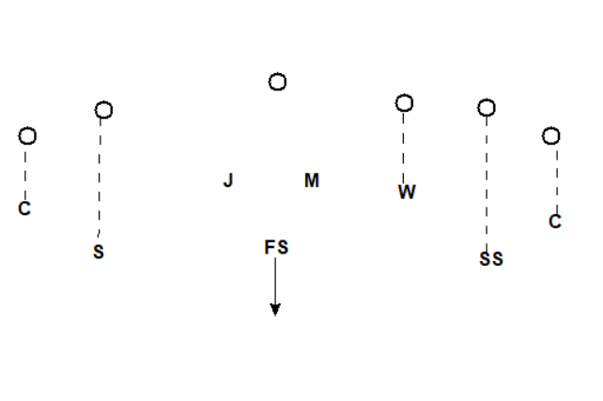
Against Common Looks
Versus Empty

Slide 70
Position | Assignments/Notes

Slide 71
Against Common Looks

Slide 72
Position | Assignments/Notes

Slide 73
Against Common Looks

Slide 74
Position | Assignments/Notes

Slide 75
Against Common Looks

Slide 76
Position | Assignments/Notes

Slide 77
Against Common Looks

Slide 78
Position | Assignments/Notes

Slide 79
Against Common Looks

Slide 80
Position | Assignments/Notes

Slide 81
Against Common Looks

Slide 82
Position | Assignments/Notes

Slide 83
Against Common Looks

Slide 84
Position | Assignments/Notes

Slide 85
Against Common Looks

Slide 86
Position | Assignments/Notes

Slide 87
Against Common Looks

Slide 88
Position | Assignments/Notes

Slide 89
Against Common Looks

Slide 91
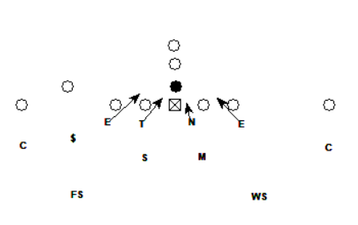
Chapter 5
Stunts
Stunts can take many shapes.
They can be simple – like moving one player or shooting a gap, but you can easily make them complex.
In order to run multiple stunts, you must plan these out with detail so that your defense can run them against a variety of looks and from a variety of looks.
Use the following pages to design or refine your stunts against specific offensive looks you want to attack.
As you progress, you may see that you prefer certain stunts against specific looks, and this will help you to build in “checks” with the defense if you choose to attack formations in a game plan.
You may also realize that you do not like this stunt against different looks and want to install a way to “kill” this call if you get that look.
The next chapter will be about creating “Packaged Calls,” so use this chapter to dive into the details of all your stunts and blitzes.
Here’s an example of a stunt:
PINCH

Slide 92
Position | Alignment/Responsibility

Slide 93
Against Other Looks

Slide 94
Position | Alignment/Responsibility

Slide 95
Against Other Looks

Slide 96
Position | Alignment/Responsibility

Slide 97
Against Other Looks

Slide 98
Position | Alignment/Responsibility

Slide 99
Against Other Looks

Slide 100
Position | Alignment/Responsibility

Slide 101
Against Other Looks

Slide 102
Position | Alignment/Responsibility

Slide 103
Against Other Looks

Slide 104
Position | Alignment/Responsibility

Slide 105
Against Other Looks

Slide 106
Position | Alignment/Responsibility

Slide 107
Against Other Looks

Slide 108
Position | Alignment/Responsibility

Slide 109
Against Other Looks

Slide 110
Position | Alignment/Responsibility

Slide 111
Against Other Looks

Slide 113
Chapter 6
Packaged Calls
Now that the bulk of the playbook is complete, you can start to marry certain concepts into packaged calls for specific situations. You might use these because the whole play might be too wordy or it’s a common call and you’d like to make it just one word.
Your defense may have just one or two of these or you might want a lot. It all depends on your players and what you’ll see from the offense.
A few examples of what you might want to package are special blitzes or perhaps when you want to drop a defensive lineman into coverage – get creative in this chapter.
These can be as exotic as you want but remember that you need to be able to teach and communicate them quickly. Think about all those things as you build them out here.
Also, make sure these blitzes will work against most fronts you will face or build in rules that will “check them out” of the call.
Here’s an example:
BAM
E
T
N
E
W
M
S
C
C
FS
SS

Slide 114
Packaged Calls

Slide 115
Packaged Calls

Slide 116
Packaged Calls

Slide 117
Packaged Calls

Slide 118
Packaged Calls

Slide 119
Packaged Calls

Slide 120
Packaged Calls

Slide 121
Packaged Calls

Slide 122
Packaged Calls

Slide 123
Packaged Calls

Slide 125
Chapter 7
Readiness Exercises
At this point, you’ve planned out your entire playbook and now you need to apply your playbook to the many situations that you and your team will face. So, in this section, we’ve provided a few key questions for you to think about now while you’ve got the time to formulate good answers as opposed to in the middle of a game when everything’s on the line.
While this section poses questions you will undoubtedly face in your career, it is not comprehensive. Take inspiration from these questions to pose new ones for yourself and your staff. The more that you go over now, the better you’ll be in season.

Slide 126
Exercise Example: Your starting FS gets injured…
Move starting corner to FS and bring in next best DB at corner
Go to a cover 3 look and bring in an additional LB/DL
Starting WR/RB moves to defense
Exercise 12: You’re facing a D1 receiver…

Slide 127
Exercise 13: You’re facing a Flexbone offense…
Exercise 14: You’re facing a Wing T offense…

Slide 128
Exercise 15: You’re facing an up-tempo team…
Exercise 16: You’re facing a heavy formation into the boundary team…

Slide 129
Exercise 17:
Exercise 18:

Slide 130
Exercise 19:
Exercise 20:

Slide 131
Exercise 21:
Exercise 22:

Slide 133
Chapter 8
Practice Plans
You’ve now made incredible progress in getting all your ideas and thoughts out on paper. Your defense is prepared to face every situation the offense can throw at you.
But if you can’t teach it in the few hours that you get every day after school in practice, it doesn’t matter how great your schemes and blitzes are.
So, use this chapter to layout a plan for how you will practice every single week. Your practice plans will differ than mine, but I’ve provided a plan for you to model on the first page. On the following pages you’ll be given a one page for each day of the week so that you can plan out practice frameworks that you can use throughout the season. Each day will be different but planning out a consistent schedule will help you make sure you cover everything you need to.
Here are a few questions to ask yourself as you plan out your week:
How much Indy time do you want each day as you get closer to game day?
How often do linebackers and the defensive line need to come together?
How much time do you want to use for pursuit drills?
How much time will be spent covering the opponents formations/plays?
The best way to think of this is to have the end goal in mind - the game - when planning each day leading up to it.
Then work to prioritize drills that will help you win the game (the next chapter will have you build out a drill book).
If you want to download an editable practice plan Excel sheet, scan the QR code below:

Slide 134
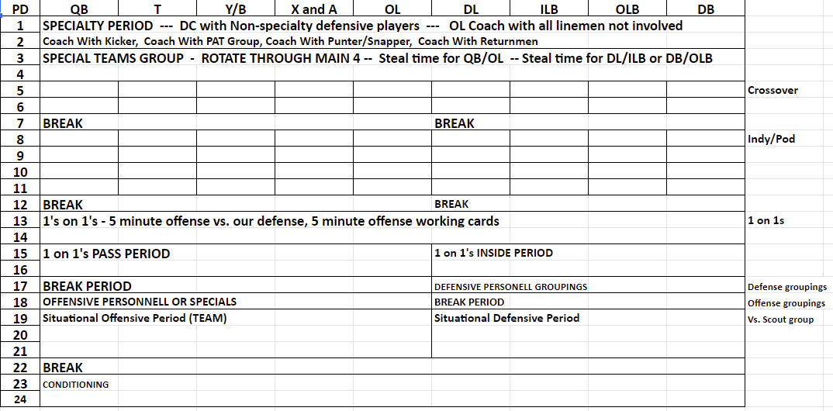
Exercise 23
Build a Practice Plan
Notes

Slide 135
Exercise 24: Preseason Practice Plan

Slide 136
Exercise 25: Monday

Slide 137
Exercise 26: Tuesday

Slide 138
Exercise 27: Wednesday

Slide 139
Thursday Example: “Play the Game”
Indy Offense - 10 Minutes
Indy Defense - 10 Minutes
KOR
Offense: Base Offense - Script of 10 Plays vs. Scout
Punt
Defense – Base Calls and Checks
Punt Return and Block - Line up
Offense - Red Zone Period - 8 Plays vs. Scout, 4 Plays from Heavy on Air
2 PT Plays - On Air
XP/FG
Kickoff
Defense - Driving the field (Hash Work)
Red Zone Defense and 3rd-down plays
FG Block
Offense -- 3rd-down plays and Specials - On Air
Offense -- Backup QB - 8 plays vs. Scout
KO -- Onside Kicks
Defense -- Nickel and Dime Defense
Hands Team
Offense – 2-minute Drill
FG Team - End of game
VICTORY

Slide 140
Exercise 28: Thursday

Slide 141
Chapter 9
Drill Book
In this chapter you will organize and record all the individual drills that you want to run for each of your position groups. Take time to think about the type of drills that are relevant to the defense you have just created in this workbook. You don’t need every drill to ever exist – you need the ones that will help your players execute your defense on game days.
This chapter is also a great time to involve your position coaches and get their drills on paper. Everyone might already have great drills, but it’s a great idea to record them all for future use. This chapter will become an invaluable resource for a new coach coming on to your defensive staff looking to learn how to teach the system. Often, a new coach will just run drills they did in high school or college without consideration for how they fit into your scheme. Your job is to align everyone with purpose in their drills.
For that reason, go into detail with each drill so that everyone is on the same page and so that you’ll ensure that each drill has a purpose within your scheme.
Each position will have a drill book and there are also team drills or general drills any player would need (pursuit and tackling would be examples of these).
Additionally, each drill should answer YES to the following questions:
Will the drills I run this week with my players prepare them for the game?
Do the drills I use with my players show up in the games they play?

Slide 142
Planning Drills
Here is an example of choosing drills to fit your athletes and the skills they need.
We chose the defensive line and went with some basic drills.
In your defensive system it is imperative that drills match skills that will help you be successful. There are multiple ways to play and win, but the teams that are successful spend time on drills that will translate to the skill set.
Think of the skill needed and THEN choose the drills. This will also help you decide on how much time to give during a practice for that skill. In Exercise 29, you will do just this.
Here’s an example for defensive linemen:
Defensive Linemen
Stance | Escapes | Run
1-step punch 2-step punch Stem drill: stem on cadence and 2 step punch on ball movement Stunts and movements from a 3-point stance | Escape moves from fit (rip, swim, throw) Escape moves out of a 3-point stance Escape moves with pursuit | Base block: From fitted position From a 3-point stance Quick board drill With a tackle finish Down block: From a fitted position With pullers With tackle finish
In the first exercise of this chapter, you’ll go through the process of how to decide which drills you need. Think of the skill you want your players to have, THEN the drills that’ll help you get them there.
The following pages will then be for you to put down all your drills. We provided 30 sheets, but if you need more, scan the QR code below:

Slide 143
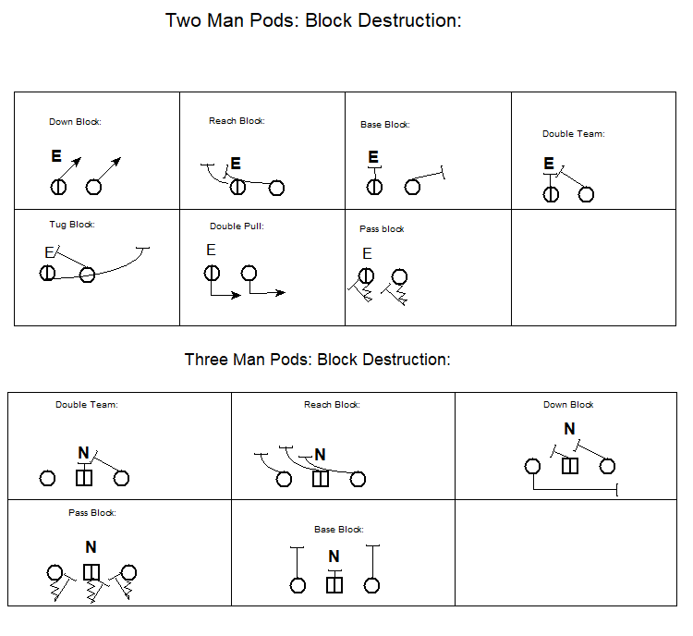
Practicing in Pods
You might also want to consider putting pods of players together to practice game situations. For example, you might bring your linebackers and linemen together to practice fits. Or you might just bring multiple players in the same position group to work their skills together. Here’s an example of defensive linemen drills addressing block destruction:

Slide 144
Exercise 29
Plan Your Drills
Fill Write the position name in the first row and then three skills you’d like to develop. Then in the white box, plan how you’ll develop that skill using drills.

Slide 145
Exercise 29 Continued

Slide 146
Exercise 29 Continued

Slide 147
Exercise 29 Continued

Slide 148
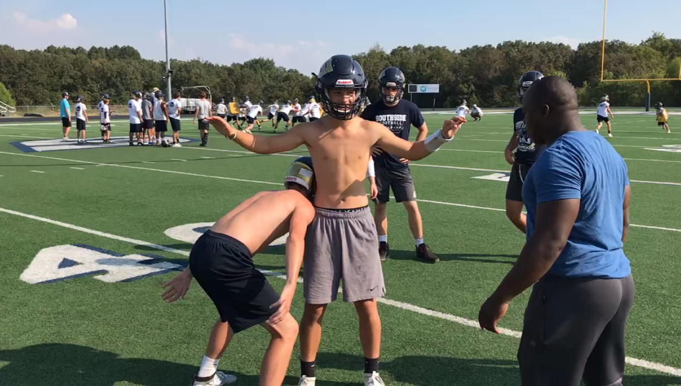
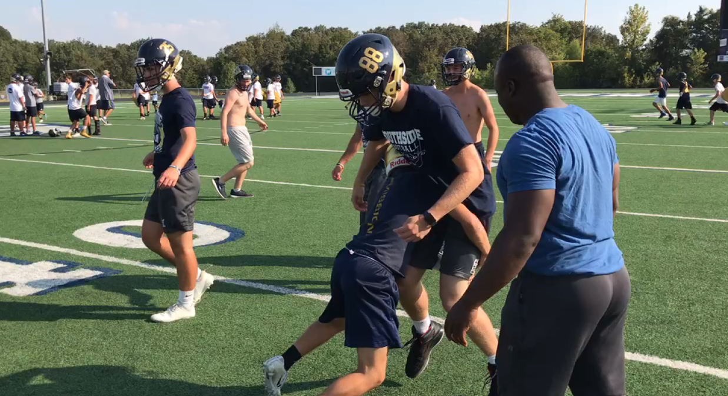
All Defensive Players
Drill: Angle Tackling Position: ALL
PURPOSE
KEY SKILLS
SETUP
Coming from space to tackle
Closing space with hot feet
Wrap arms and run feet.
Working to pursue angles
Keep feet moving and close space
If possible, use cones for aiming points for the runners
Can be done on any part of the field
DRILL INSTRUCTIONS
“Runner” will go slowly towards a cone
Tackler will close space and wrap and run partner back
COMMON MISTAKES
Tackler forgets to keep eyes up
Feet stop or too large steps
Does not run through contact.
COACHING POINTS
Keep running feet through the tackle
Do not allow them to lunge
Work to extend space as athletes become more competent

Slide 149
Drill: Position:
PURPOSE
KEY SKILLS
SETUP
DRILL INSTRUCTIONS
DIAGRAM DRILL
COMMON MISTAKES
COACHING POINTS

Slide 150
Drill: Position:
PURPOSE
KEY SKILLS
SETUP
DRILL INSTRUCTIONS
DIAGRAM DRILL
COMMON MISTAKES
COACHING POINTS

Slide 151
Drill: Position:
PURPOSE
KEY SKILLS
SETUP
DRILL INSTRUCTIONS
DIAGRAM DRILL
COMMON MISTAKES
COACHING POINTS

Slide 152
Drill: Position:
PURPOSE
KEY SKILLS
SETUP
DRILL INSTRUCTIONS
DIAGRAM DRILL
COMMON MISTAKES
COACHING POINTS

Slide 153
Drill: Position:
PURPOSE
KEY SKILLS
SETUP
DRILL INSTRUCTIONS
DIAGRAM DRILL
COMMON MISTAKES
COACHING POINTS

Slide 154
Drill: Position:
PURPOSE
KEY SKILLS
SETUP
DRILL INSTRUCTIONS
DIAGRAM DRILL
COMMON MISTAKES
COACHING POINTS

Slide 155
Drill: Position:
PURPOSE
KEY SKILLS
SETUP
DRILL INSTRUCTIONS
DIAGRAM DRILL
COMMON MISTAKES
COACHING POINTS

Slide 156
Drill: Position:
PURPOSE
KEY SKILLS
SETUP
DRILL INSTRUCTIONS
DIAGRAM DRILL
COMMON MISTAKES
COACHING POINTS

Slide 157
Drill: Position:
PURPOSE
KEY SKILLS
SETUP
DRILL INSTRUCTIONS
DIAGRAM DRILL
COMMON MISTAKES
COACHING POINTS

Slide 158
Drill: Position:
PURPOSE
KEY SKILLS
SETUP
DRILL INSTRUCTIONS
DIAGRAM DRILL
COMMON MISTAKES
COACHING POINTS

Slide 159
Drill: Position:
PURPOSE
KEY SKILLS
SETUP
DRILL INSTRUCTIONS
DIAGRAM DRILL
COMMON MISTAKES
COACHING POINTS

Slide 160
Drill: Position:
PURPOSE
KEY SKILLS
SETUP
DRILL INSTRUCTIONS
DIAGRAM DRILL
COMMON MISTAKES
COACHING POINTS

Slide 161
Drill: Position:
PURPOSE
KEY SKILLS
SETUP
DRILL INSTRUCTIONS
DIAGRAM DRILL
COMMON MISTAKES
COACHING POINTS

Slide 162
Drill: Position:
PURPOSE
KEY SKILLS
SETUP
DRILL INSTRUCTIONS
DIAGRAM DRILL
COMMON MISTAKES
COACHING POINTS

Slide 163
Drill: Position:
PURPOSE
KEY SKILLS
SETUP
DRILL INSTRUCTIONS
DIAGRAM DRILL
COMMON MISTAKES
COACHING POINTS

Slide 164
Drill: Position:
PURPOSE
KEY SKILLS
SETUP
DRILL INSTRUCTIONS
DIAGRAM DRILL
COMMON MISTAKES
COACHING POINTS

Slide 165
Drill: Position:
PURPOSE
KEY SKILLS
SETUP
DRILL INSTRUCTIONS
DIAGRAM DRILL
COMMON MISTAKES
COACHING POINTS

Slide 166
Drill: Position:
PURPOSE
KEY SKILLS
SETUP
DRILL INSTRUCTIONS
DIAGRAM DRILL
COMMON MISTAKES
COACHING POINTS

Slide 167
Drill: Position:
PURPOSE
KEY SKILLS
SETUP
DRILL INSTRUCTIONS
DIAGRAM DRILL
COMMON MISTAKES
COACHING POINTS

Slide 168
Drill: Position:
PURPOSE
KEY SKILLS
SETUP
DRILL INSTRUCTIONS
DIAGRAM DRILL
COMMON MISTAKES
COACHING POINTS

Slide 169
Drill: Position:
PURPOSE
KEY SKILLS
SETUP
DRILL INSTRUCTIONS
DIAGRAM DRILL
COMMON MISTAKES
COACHING POINTS

Slide 170
Drill: Position:
PURPOSE
KEY SKILLS
SETUP
DRILL INSTRUCTIONS
DIAGRAM DRILL
COMMON MISTAKES
COACHING POINTS

Slide 171
Drill: Position:
PURPOSE
KEY SKILLS
SETUP
DRILL INSTRUCTIONS
DIAGRAM DRILL
COMMON MISTAKES
COACHING POINTS

Slide 172
Drill: Position:
PURPOSE
KEY SKILLS
SETUP
DRILL INSTRUCTIONS
DIAGRAM DRILL
COMMON MISTAKES
COACHING POINTS

Slide 173
Drill: Position:
PURPOSE
KEY SKILLS
SETUP
DRILL INSTRUCTIONS
DIAGRAM DRILL
COMMON MISTAKES
COACHING POINTS

Slide 174
Drill: Position:
PURPOSE
KEY SKILLS
SETUP
DRILL INSTRUCTIONS
DIAGRAM DRILL
COMMON MISTAKES
COACHING POINTS

Slide 175
Drill: Position:
PURPOSE
KEY SKILLS
SETUP
DRILL INSTRUCTIONS
DIAGRAM DRILL
COMMON MISTAKES
COACHING POINTS

Slide 176
Drill: Position:
PURPOSE
KEY SKILLS
SETUP
DRILL INSTRUCTIONS
DIAGRAM DRILL
COMMON MISTAKES
COACHING POINTS

Slide 177
Drill: Position:
PURPOSE
KEY SKILLS
SETUP
DRILL INSTRUCTIONS
DIAGRAM DRILL
COMMON MISTAKES
COACHING POINTS

Slide 178
Drill: Position:
PURPOSE
KEY SKILLS
SETUP
DRILL INSTRUCTIONS
DIAGRAM DRILL
COMMON MISTAKES
COACHING POINTS

Slide 179
Chapter 10
Opponent Breakdown
There could be an entire book on breaking down an opponent, but we wanted to include at least one chapter going over this task because it’s vital to your success as a defensive coordinator.
These exercises will specifically go over breaking down the personnel of an opponent. After recording each of the opponent’s positions and players, take notes on each player. Just like in building your own defense, when studying another team, always start with their personnel. Before you think about their scheme, think about the matchups your players will be facing.
Then, work to ensure your players are as prepared as possible for an opponent by studying their tendencies.
There are a ton of resources available to coaches and we’d highly recommend as a coach you always evolve how you breakdown opponents.
In this workbook, there are 10 sheets to breakdown your opponents’ personnel, and then two sheets that give you templates for ”padding” your opponent and tracking common plays.
We’ve only included examples in this workbook because you’ll need dozens and dozens of them throughout the season. So, to print off more, please scan the QR code below

Slide 180
Padding Your Opponent
Play #: | Personnel: | D/D
Formation: | Motion/Shift: | Play:
0 0
0 0
0 0
0 0
0
0
Play #: | Personnel: | D/D
Formation: | Motion/Shift: | Play:
0 0
0 0
0 0
0 0
0
0

Slide 181
Opponent Padding - Plays
NOTES:

Slide 182
Exercise 30
Analyze Opponent Depth Chart
Go through the opponent game film and determine the personnel and positions on the left-hand column. In the right-hand columns, record the player numbers and brief notes on the players. In the bottom section, record strengths and weakness you see in the offensive players and scheme.
Position | Players
Strengths | Weaknesses

Slide 183
Opponent
Position | Players
Strengths | Weaknesses

Slide 184
Opponent
Position | Players
Strengths | Weaknesses

Slide 185
Opponent
Position | Players
Strengths | Weaknesses

Slide 186
Opponent
Position | Players
Strengths | Weaknesses

Slide 187
Opponent
Position | Players
Strengths | Weaknesses

Slide 188
Opponent
Position | Players
Strengths | Weaknesses

Slide 189
Opponent
Position | Players
Strengths | Weaknesses

Slide 190
Opponent
Position | Players
Strengths | Weaknesses

Slide 191
Opponent
Position | Players
Strengths | Weaknesses

Slide 193
Chapter 11
Opponent Gameplanning
While printing off the Hudl report is a good start, doing an opponent breakdown by hand seems to always provide more value.
The goal of this section is to give just one way to look at scouting an opponent. Once again, this could easily be an entire book, but we want to give some simple forms and an example of what a coach could give to their athletes after breaking down an opponent.
So, use this template to take all your breakdown data and put it onto a piece of paper in a concise way that’ll give you, your staff, and your players the need-to-know information about the opponent and their tendencies.
You’ll need perhaps two to six of these for every opponent, so we’ve only included one in here. To download more, scan the QR code below:

Slide 194
Personnel: | Formation: | Times Ran:
Weak Coverages | Strong Coverages
Weak Pressures | Strong Pressures
Weak Stunts | Strong Stunts

Slide 195
Chapter 12
Build a Call Sheet
Calling plays is one of the more difficult portions of the job. Having an effective sheet can help with this. In this chapter you should work through each formation and play in your offense.
You will notice that the example call sheet addresses the following situations:
New formations
Red Zone
2 Point Conversions
Key Players
In Exercise 31, brainstorm the situations you need to address in your call sheet and then build one out for yourself.
Here’s a call sheet example:
You can also download it by scanning the QR code:

Slide 196
Exercise 31
Call Sheet Brainstorming

Slide 197
Chapter 13
Game Management
You’ve finally got all the work done creating a defense and working through all the situations that your defense will face on the field.
And the last thing you need to prepare for is your own sideline.
Use this chapter to plan your game management strategy so that all the hard work you’ve done in the offseason and practice is optimized in the games. Everyone needs to be able to communicate effectively and everyone needs to know their roles.
These are the questions you need to answer if you want you and your assistant to coach during games efficiently:
Who watches what?
Who communicates with the Defensive Coordinator?
Who will make in-game adjustments?
You must think through all these questions before the game starts.
On the next two pages, you will see an example of how to organize in-game and halftime procedures. Then, there will be room for you to brainstorm your own operations.

Slide 198
Sideline Management Example
General Guidelines:
Only Coach _______ will speak with and deal with officials. If you have a concern let him know.
Remain calm on the sideline so that our athletes will follow our lead. Energy is great, but we need steady adjustments and to be a calming influence on our athletes.
Remember you represent our school. No one wants to lose, but if we expect our athletes to remain under control we must also.
Coaches’ Roles
DC - Time management, Game management, Overall management. While each coach will be responsible for their groups, Coach _______ has final say on all personnel or scheme decisions.
DB - Defensive Back rotations, adjustments and personnel. Will use the TV while the offense is on the field. Game plan management and notes for adjustments.
DL - Defensive line rotations, adjustments and personnel. Will use the TV while the offense is on the field.
Box Defense - Have game plan in the booth. Assist with adjustments as needed.
Use the next pages to come up with your plan of action.
​

Slide 199
Halftime Organization Example
Things that must take place during half time:
Players must be given time to rest.
All injury and equipment problems taken care of.
Staff must analyze the first half and make plans for the second half.
Players must be re-motivated to play the final and most important part of the game.
Halftime divided into four periods:
First period (four minutes).
Staff meetings.
Team rest.
Injury and equipment care.
Second period (four minutes).
Offense and Defensive position coaches meet with assigned groups.
Third period Offense and defensive Coordinators meet with their entire offense or defensive squads. (Four minutes).
Fourth period (four minutes)
Head coach meets with both offense and defense as a team.
Return to field for warm-up.
In order to stay on schedule we will assign a staff member to keep meeting times on schedule. One coach or manager will be responsible for keeping the time as well as letting the head coach know how much time is left before the start of the second half.
Use the next pages to organize your half time and in-game adjustment plan.
​

Slide 200
Exercise 32
Organize the Sideline
​

Slide 201
Exercise 33
Organize Halftime
​

Slide 203
Conclusion
It has been my goal to create a workbook like this one for a few seasons and we were able to create one for Offensive Coordinators in the winter of 2021. Now here’s one for Defensive Coordinators and my hope is that after working through all these exercises, you now have a better understanding of your own system.
More importantly, I hope that you see this workbook as a plan of action for your team this season.
Feel free to reach out with questions.
My contact information is:
FBCoachSimpson@gmail.com
334-549-9382
If you’d like to check out my own systems, scan the QR code below:

Slide 205
About the Authors
Kenny Simpson is a football coach in Arkansas and the creator of the 34 Fit and Swarm Defense and the Gun T RPO Offensive System.
With experience as a Head Coach at three different schools, Coach Simpson has learned what it takes to transform a program into a winning organization. Taking over a program that had won eight games in five seasons and had been on a 20-plus game losing streak, Coach Simpson led Southside Charter High School to the playoffs for four-consecutive seasons and won two conference titles. For his efforts, he was named 4A-2 Conference Coach of the Year (2017), a finalist for Hooten's Coach of the Year (2017) and was the All-Star Nominee for the 4A-2 (2016 and 2019).
He is married to Jamey and has three children: Avery, Braden and Bennett. The couple was married in 2001 after meeting at Harding University.

Slide 206
About the Authors
Quint Ashburn is a football coach in Searcy, Arkansas. He graduated from Ouachita Baptist University in 2012 where he was a part of the football team under head coach Todd Knight.
His is married to Maggie and has a child, Liam.
Emory Wilhite is a football coach at Leon High School in Tallahassee, Florida.

